Slide 1







Revisiting Visitors for Modular Extension of Executable DSMLs
Manuel Leduc, Thomas Degueule, Benoit Combemale, Tijs van der Storm, Olivier Barais
Notes:
Logo : inria, cwi, diverse, swat (TODO), université rennes 1, gemoc, ale (TODO), crossminer
About revisitors, a language implementation pattern that allows independent extensiblity of the syntax and the semantics
Hello I’m manuel leduc
I will present …, the work we did with … at inria’s diverse team in collaboration with swat’s cwi team for the ale associate team

Slide 2
Context & Objectives

Slide 3






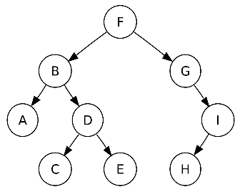






DSLs Everywhere
Notes:
Evolves a lot, different versions developed incrementally, some reuse other
A lot of the share common concepts
Some are composed of concepts directly imported from the others
We’d like to be able to reuse the modularily

Slide 4
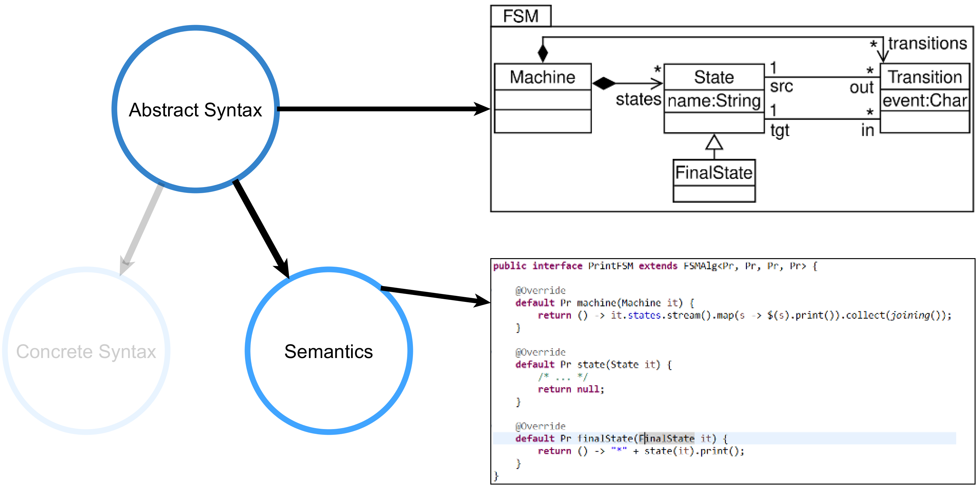
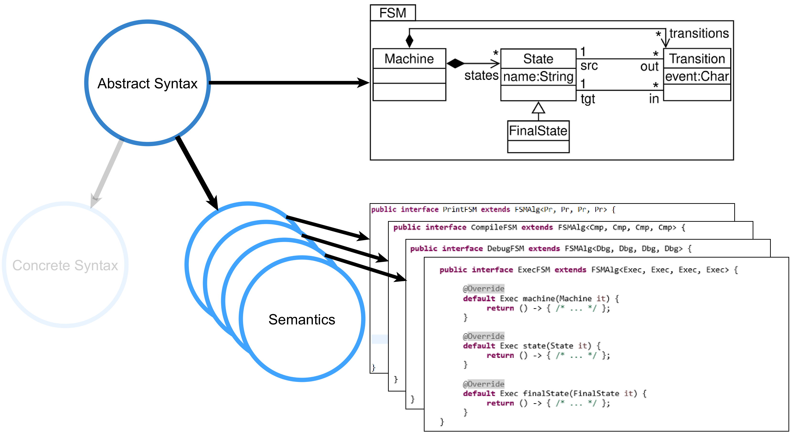
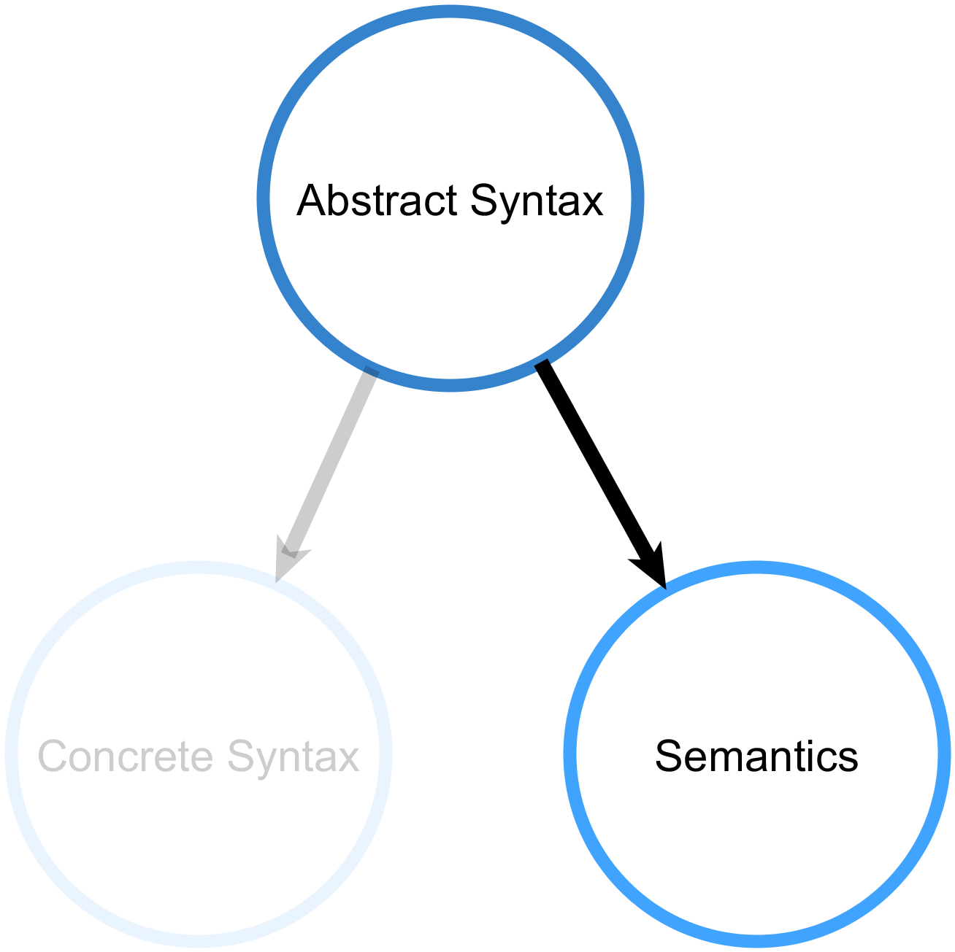
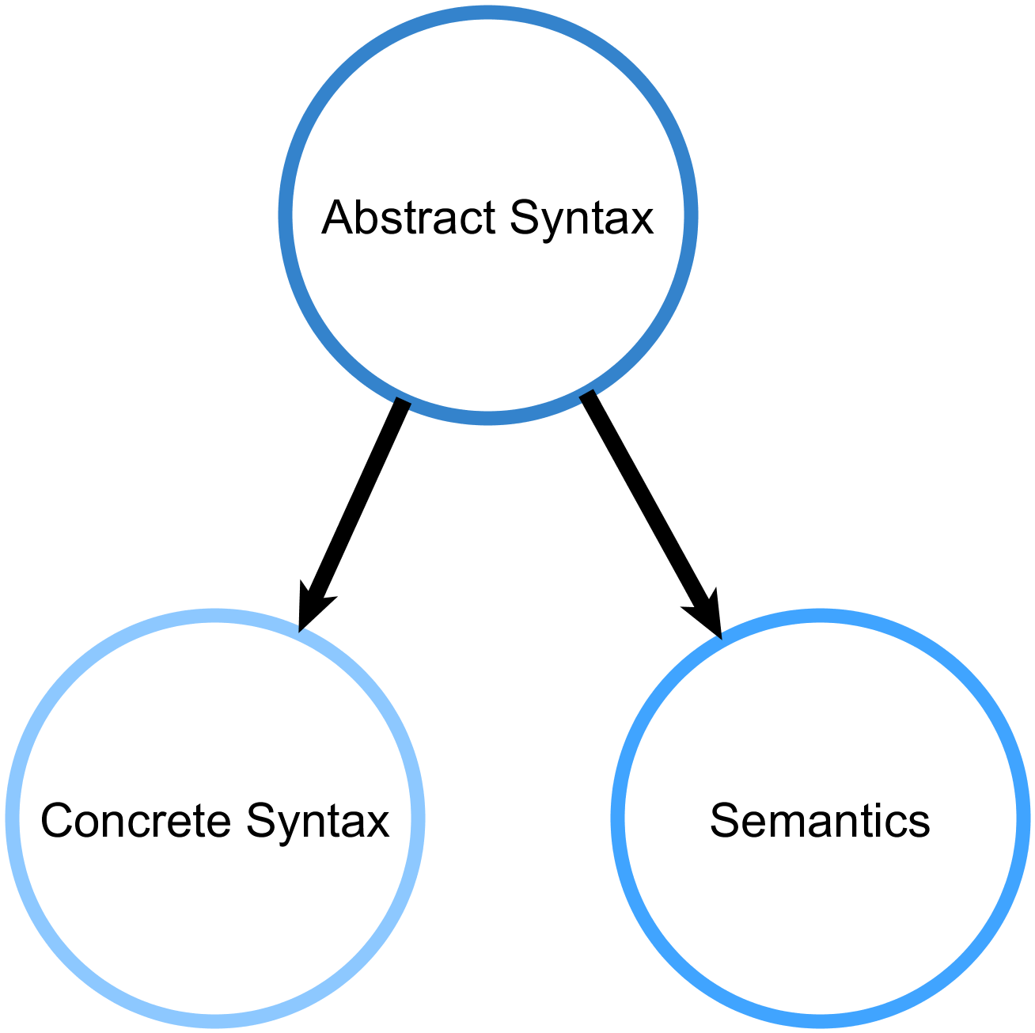
Anatomy of a xDSML
Notes:
Abstract Syntax ⬄ Metamodel
Represent language concepts as a set of metamodel classes and their relations
Declared Explicitly
Mutable
Statically typed
Execution Semantics
Assign meaning to the syntax constructs
Usually defined by an interpreter
Implements it operational semantics in the form of transition function over model states
TODO : remplacer les sources par autre chose !!!

Slide 5
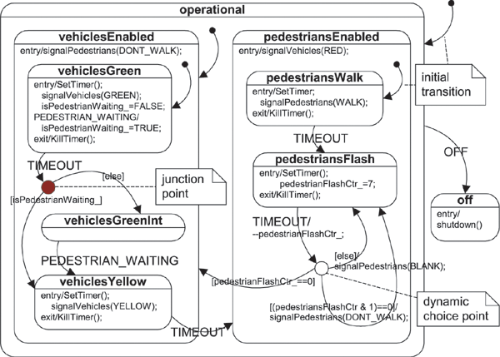
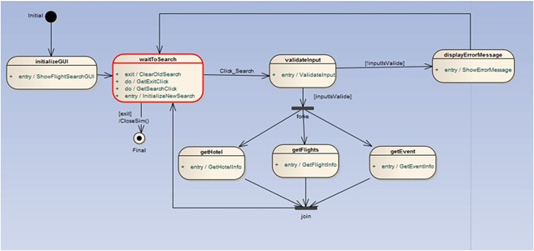
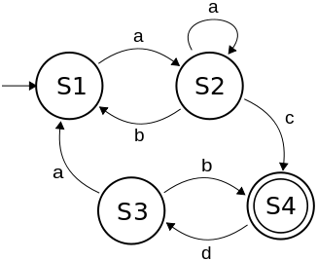
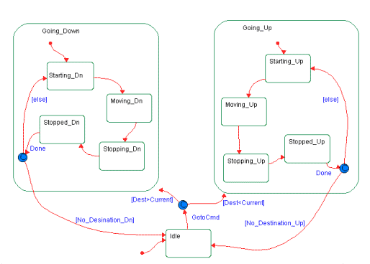
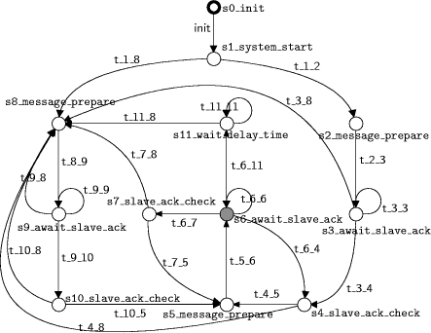
A FSM Family
Notes:
A lot of way to represent almost the same thing
- Justify the notion of « recurrent task »
- Shares recurrent paradigms => extension operations

Slide 6
Problem
Notes:
Montrer example de visitor / interpreter
Dire que visitor intrusif du côté du model
Bien expliquer ce qu’est la recompilation
Bien expliquer les conséquence de l’opportunistic reuse (on ne peut pas toucher à un composant existant)

Slide 7
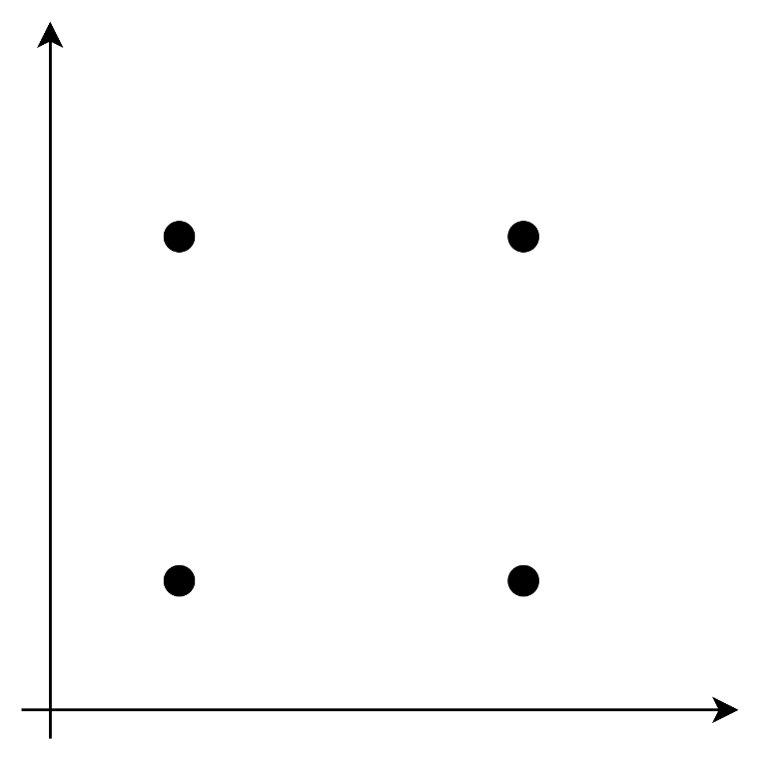
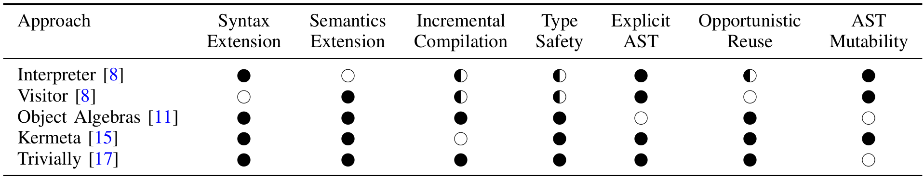
The expression problem
Semantics
Executable
xFSM
xgFSM
∅
FSM
gFSM
Syntax
FSM
Guarded FSM
Notes:
Incremental compilation => parce que le code compilé est parfois modifié à la main // le code compilé est distribué sans la spec
Opportunistic reuse => parce que facilité pour la définition d’outils (mm first class entity)
TODO : Retoucher pour ajouter un highligh sur la partie exécution / guarded
Interpreter = adding an syntactic element means modifying every defined visitor
Interpreter = adding a new semantics means altering every syntactic element
Trouver bon example dans P. Wadler, “The Expression Problem,” http://homepages.inf.ed.ac.uk/wadler/papers/expression/expression.txt, Nov. 1998, Java Genericity mailing list.

Slide 8
Incremental Compilation & Opportunistic Reuse
Incremental compilation:
Not always access to the source code
Non linear compilation penalty
Opportunistic reuse:
No intrusion on modeling framework
Reuse of legacy artifacts
Notes:
Incremental compilation = because you don’t always have access to the specification of previously defined component
Opportunistic reuse =
Incremental compilation
Existing implementations of the syntax and semantics of language modules should
not be modified, duplicated, or recompiled. Whole language
compilation would require access to the source code of the
base language (which might not be available), and would incur
a non-linear performance penalty when compiling extensions.
Opportunistic reuse :
It should be possible to reuse existing implementations of languages without anticipation. A
pattern relying on anticipation would require refactoring current
modeling frameworks (e.g., EMF) to regenerate existing code,
for instance to insert accept methods to support the Visitor
pattern. This would prevent the applicability of the solution
to legacy artifacts generated from widely-used modeling
frameworks and complicate the work of language designers.

Slide 9
In the context of MDE
Explicit AST
AST Mutability
Type safety
Notes:
Because in the DSML/MDE community this is the norm to have tools interacting with the model (so it has to be explicit), to modify it in place and with type safety (because tools have to be conform with the metamodel).
In the context of MDE, where explicit abstract syntax structures and mutability of models are prevalent

Slide 10
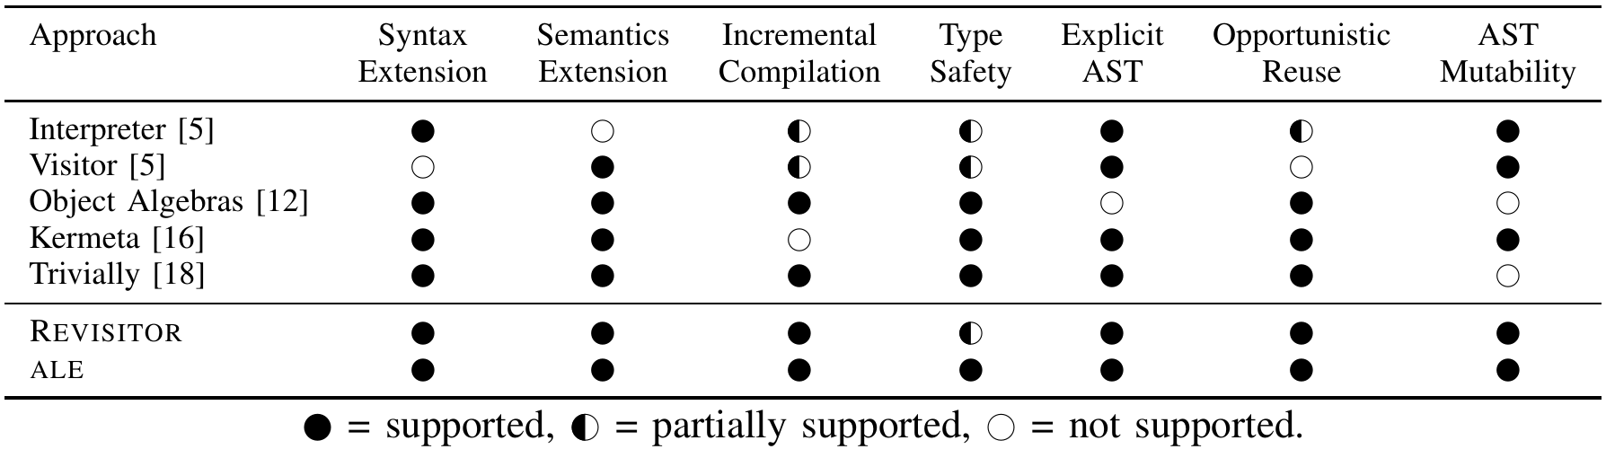
ALE & Revisitor

Slide 11
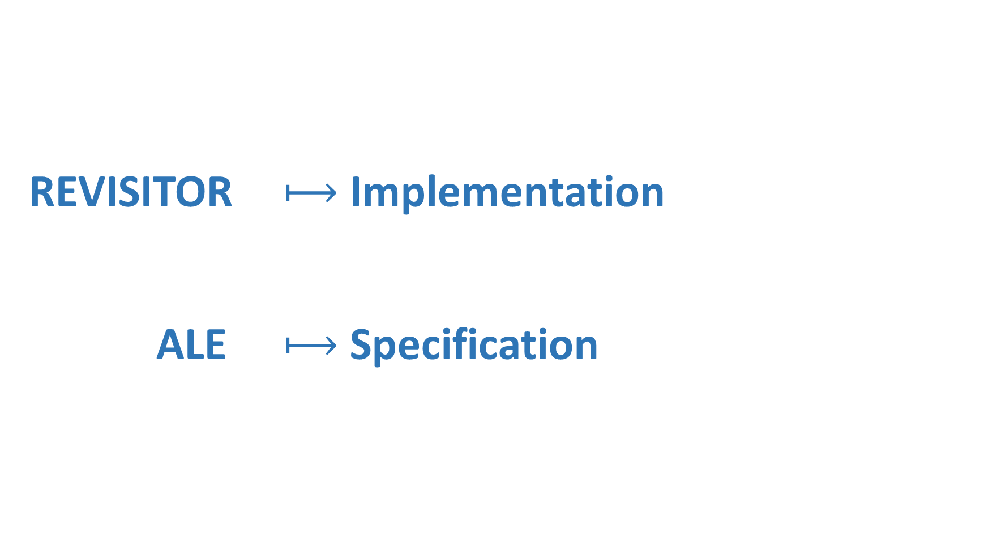
REVISITOR $⟼$ Implementation ALE $⟼$ Specification

Slide 12
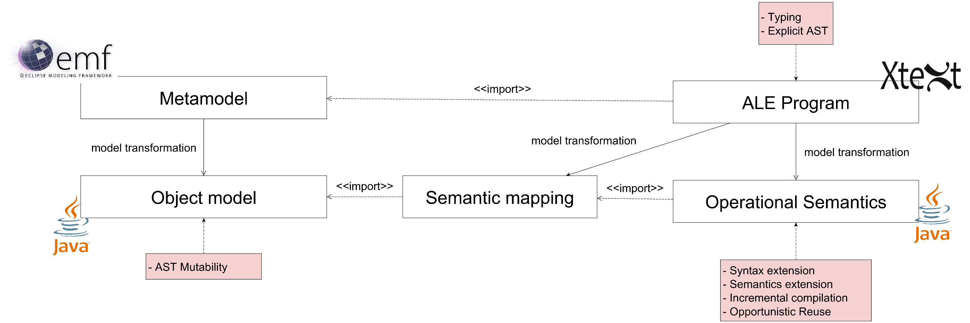
REVISITOR + ALE
Specification
Implementation
$$f:Syn ⟼Sem$$
Notes:
Implementation level =
A semantic mapping from syntax to semantics
Independent and modular semantics definition
By decoupling syntax and semantics
Specification level =
explicit metamodel with ecore
Operational semantics with ALE Lang (Action Language for Ecore) // Object Oriented ~java like + Open class mechanism
Abstract the implementation details

Slide 13
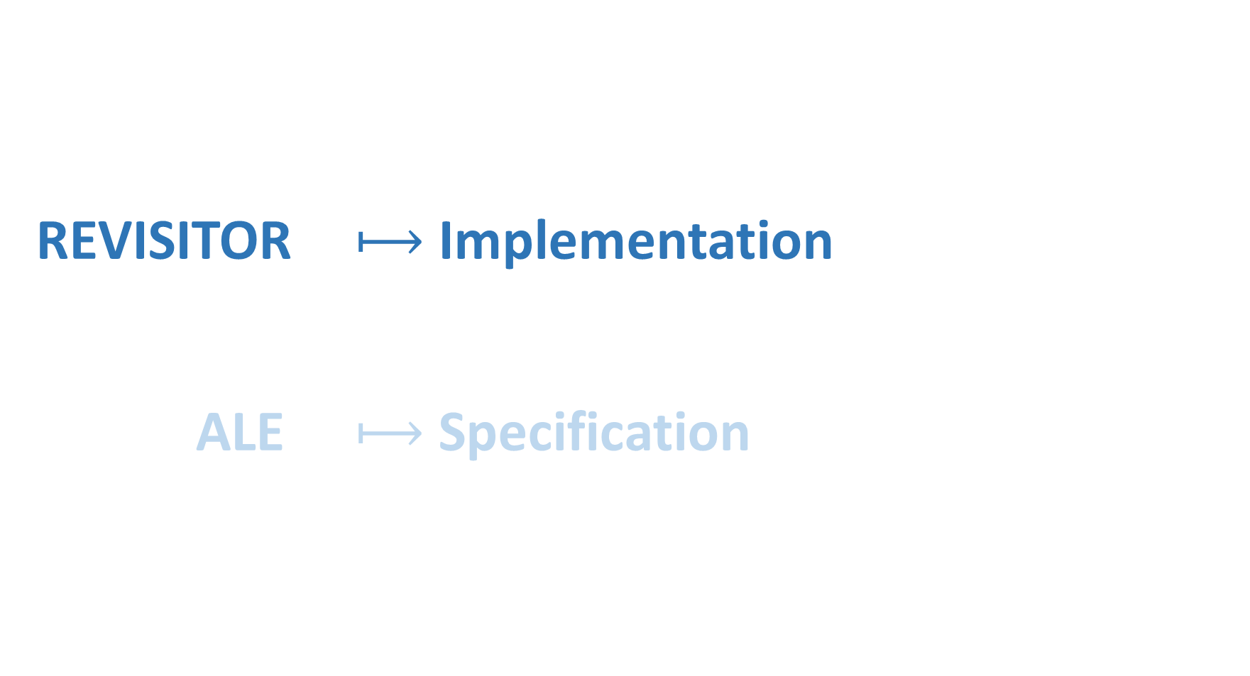
REVISITOR $⟼$ Implementation ALE $⟼$ Specification

Slide 14
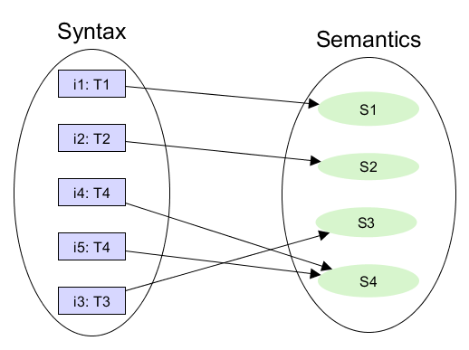
Abstract mapping
$$f:Syn ⟼Sem$$
Notes:
represent meta model by a generic factory interface for mapping syntax to a structure representing a particular semantics
dispatch method = $-method<- f
Abstract factory method = denotation
(abstract) semantics object

Slide 15
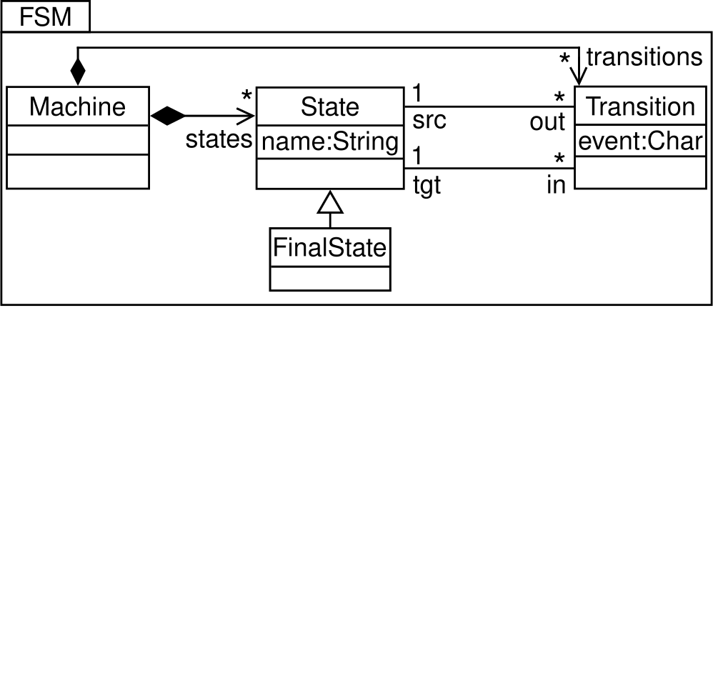
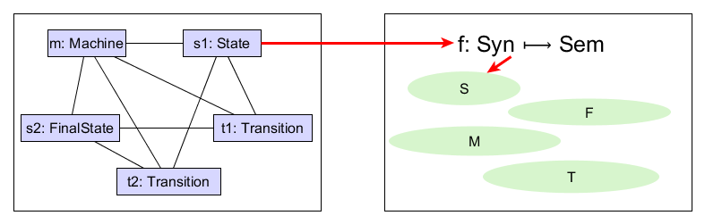
A Simple FSM Language
Notes:
dispatch method = $-method
Abstract factory method = denotation
(abstract) semantics object
Maps to the most specific implementation, much like the dynamic dispatch in java polymorphism

Slide 16

REVISITOR Interface
FSM Semantic mapping implementation
interface FSMRev<M, S, F extends S, T> {
F finalState(FinalState it);
S state(State it);
M machine(Machine it);
[…]
default M $(Machine it) { return machine(it); }
default F $(FinalState it) { return finalState(it); }
default S $(State it) {
if(it instanceof FinalState)
return finalState((FinalState) it);
return state(it);
}
}
Notes:
The dispatch methods dispartches to the most specific abstract factory methods (dynamic type dispatch)
dispatch method = $-method
Abstract factory method = denotation
(abstract) semantics object

Slide 17
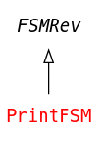
REVISITOR Implementation : Pretty Printer
Pr p = new PrintFsm() {}.$(myMachine);
System.out.println(p.print());
FSM Semantics implementation
interface Pr { String print(); }
interface PrintFSM extends FSMRev<Pr, Pr, Pr, Pr> {
default Pr machine(Machine it) {
return () -> it.states.stream().map(s ->
$(s).print()).collect(joining());
}
default Pr state(State it) { /* ... */ }
default Pr finalState(FinalState it) {
return () -> "*" + state(it).print();
}
default Pr transition(Transition it) {
return () -> it.event + " => " + it.target.name;
}
}
interface FSMRev<M, S, F extends S, T> {
F finalState(FinalState it);
S state(State it);
M machine(Machine it);
[…]
default M $(Machine it) { return machine(it); }
default F $(FinalState it) { return finalState(it); }
default S $(State it) {
if(it instanceof FinalState)
return finalState((FinalState) it);
return state(it);
}
}
Notes:
If you don’t like java, a conceptual schema (of the FSM familly) will is on the top righ corner
Top right corner -> conceptual (growing) model of the FSM family
The dispatch methods dispartches to the most specific abstract factory methods (dynamic type dispatch)

Slide 18
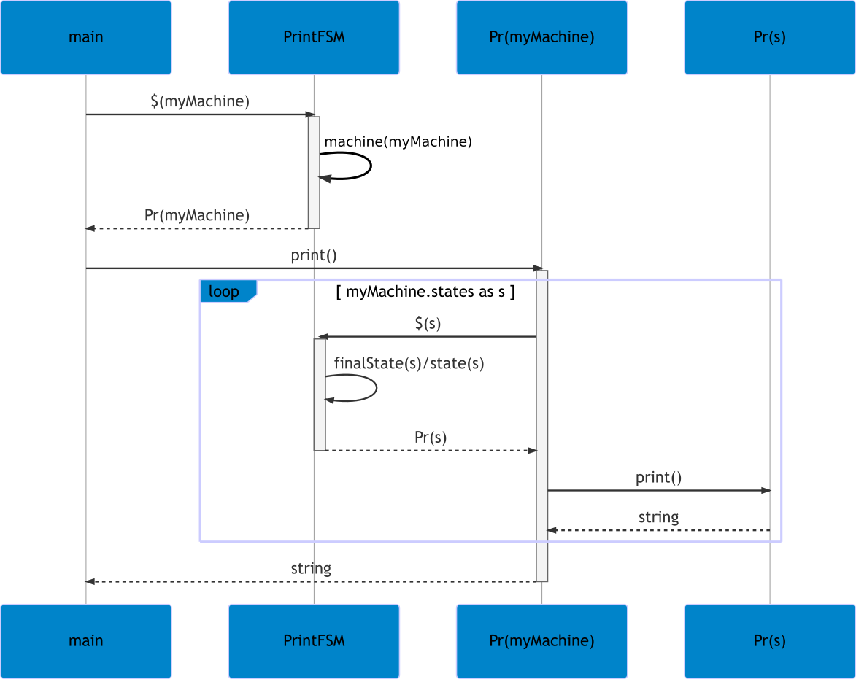
REVISITOR @Runtime
Pr p = new PrintFsm() {}.$(myMachine);
System.out.println(p.print());
interface FSMRev<M, S, F extends S, T> {
F finalState(FinalState it);
S state(State it);
M machine(Machine it);
[…]
default M $(Machine it) { return machine(it); }
default F $(FinalState it) { return finalState(it); }
default S $(State it) {
if(it instanceof FinalState)
return finalState((FinalState) it);
return state(it);
}
}
interface Pr { String print(); }
interface PrintFSM extends FSMRev<Pr, Pr, Pr, Pr> {
default Pr machine(Machine it) {
return () -> it.states.stream().map(s ->
$(s).print()).collect(joining());
}
default Pr state(State it) { /* ... */ }
default Pr finalState(FinalState it) {
return () -> "*" + state(it).print();
}
default Pr transition(Transition it) {
return () -> it.event + " => " + it.target.name;
}
}
Notes:
Top right corner -> conceptual (growing) model of the FSM family
The dispatch methods dispartches to the most specific abstract factory methods (dynamic type dispatch)
dispatch method = $-method
Abstract factory method = denotation
(abstract) semantics object

Slide 19
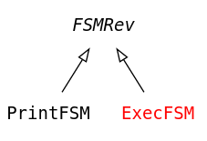
REVISITOR Implementation : Execution
Pr p = new PrintFsm() {}.$(myMachine);
System.out.println(p.print());
Independent FSM Semantics implementation
interface Pr { String print(); }
interface PrintFSM extends FSMRev<Pr, Pr, Pr, Pr> {
default Pr machine(Machine it) {
return () -> it.states.stream().map(s ->
$(s).print()).collect(joining());
}
default Pr state(State it) { /* ... */ }
default Pr finalState(FinalState it) {
return () -> "*" + state(it).print();
}
default Pr transition(Transition it) {
return () -> it.event + " => " + it.target.name;
}
}
interface FSMRev<M, S, F extends S, T> {
F finalState(FinalState it);
S state(State it);
default F $(FinalState it) { return finalState(it); }
default S $(State it) {
if(it instanceof FinalState)
return finalState((FinalState) it);
return state(it);
}
}
interface Exe { void exe(); }
interface ExeFSM extends FSMRev<Exe, Exe, Exe, Exe> {
default Exe machine(Machine it) {
return () /* ... */
}
/* ... */
}
Notes:
The dispatch methods dispartches to the most specific abstract factory methods (dynamic type dispatch)
this interface is extensible, and can be implemented multiple times

Slide 20
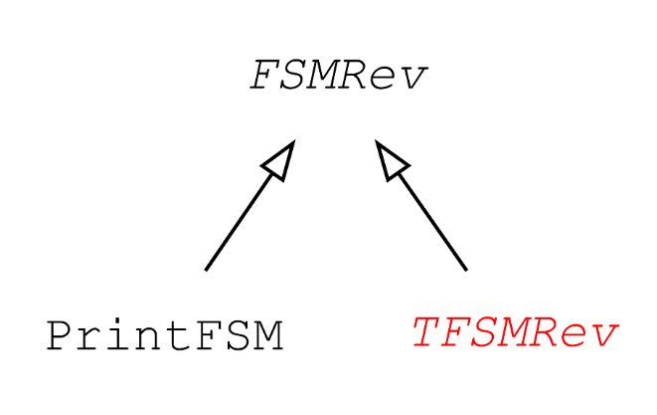
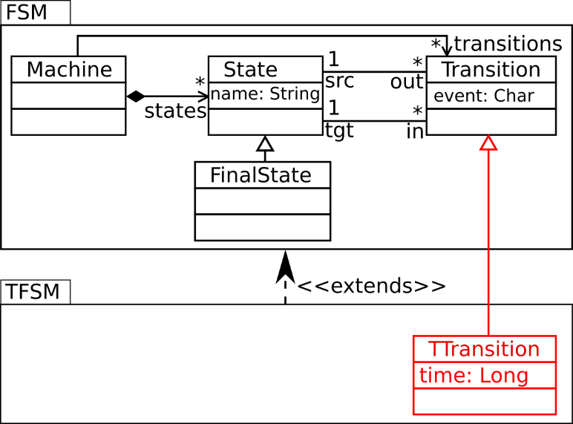
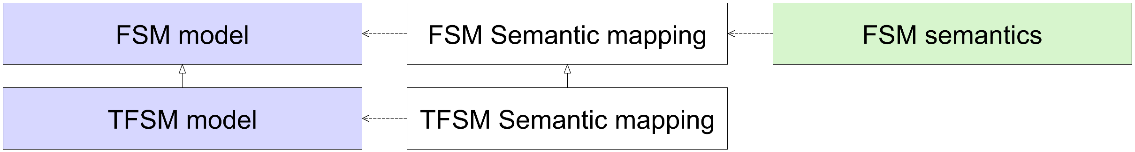
Syntax Extensibility: Timed Transitions
TFSM semantic mapping implementation
interface TFSMRev<M, S, F extends S, T, TT extends T> extends FSMRev<M, S, F, T> {
TT tTransition(TTransition it);
default TT $(TTransition it) { return tTransition(it); }
@Override default T $(Transition it) {
if (it instanceof TTransition) return tTransition((TTransition) it);
return transition(it);
}
}
Notes:
New abstract factory method (denotation)
New dispatch method
Redefinition the dispatch methods of the hierarchy

Slide 21
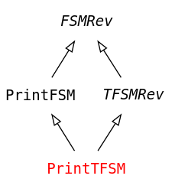
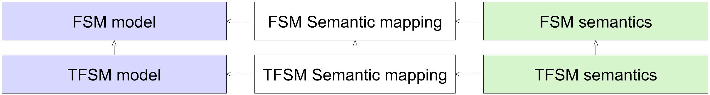
Semantics Extensibility: Timed Transitions
TFSM Semantics implementation
interface TFSMRev<M, S, F extends S, T, TT extends T> extends FSMRev<M, S, F, T> {
TT tTransition(TTransition it);
default TT $(TTransition it) { return tTransition(it); }
@Override default T $(Transition it) {
if (it instanceof TTransition) return tTransition((TTransition) it);
return transition(it);
}
}
interface PrintTFSM extends PrintFSM,
TFSMRev<Pr, Pr, Pr, Pr, Pr> {
@Override
default Pr tTransition(TTransition it) {
return () -> it.time + "@" + transition(it).print();
}
}
Notes:
Ajouter un schéma de la structure d’héritage java ?

Slide 22
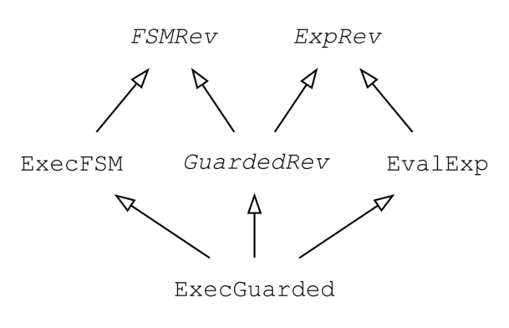
Independent extensibility
Notes:
Executable FSM
+
Expression language
=
Guarded FSM
Generation of the new semantics mapping
+ A few lines of glue code

Slide 23
Too many Generics, too much boilerplate
interface ActivitydiagramRevisitor<Activitydiagram__ActionT extends Activitydiagram__ExecutableNodeT,Activitydiagram__ActivityT extends Activitydiagram__NamedElementT,Activitydiagram__ActivityEdgeT extends Activitydiagram__NamedElementT,Activitydiagram__ActivityFinalNodeT extends Activitydiagram__FinalNodeT,Activitydiagram__ActivityNodeT extends Activitydiagram__NamedElementT,Activitydiagram__BooleanBinaryExpressionT extends Activitydiagram__BooleanExpressionT,Activitydiagram__BooleanExpressionT extends Activitydiagram__ExpressionT,Activitydiagram__BooleanUnaryExpressionT extends Activitydiagram__BooleanExpressionT,Activitydiagram__BooleanValueT extends Activitydiagram__ValueT,Activitydiagram__BooleanVariableT extends Activitydiagram__VariableT,Activitydiagram__ControlFlowT extends Activitydiagram__ActivityEdgeT,Activitydiagram__ControlNodeT extends Activitydiagram__ActivityNodeT,Activitydiagram__DecisionNodeT extends Activitydiagram__ControlNodeT,Activitydiagram__ExecutableNodeT extends Activitydiagram__ActivityNodeT,Activitydiagram__ExpressionT,Activitydiagram__FinalNodeT extends Activitydiagram__ControlNodeT,Activitydiagram__ForkNodeT extends Activitydiagram__ControlNodeT,Activitydiagram__InitialNodeT extends Activitydiagram__ControlNodeT,Activitydiagram__IntegerCalculationExpressionT extends Activitydiagram__IntegerExpressionT,Activitydiagram__IntegerComparisonExpressionT extends Activitydiagram__IntegerExpressionT,Activitydiagram__IntegerExpressionT extends Activitydiagram__ExpressionT,Activitydiagram__IntegerValueT extends Activitydiagram__ValueT,Activitydiagram__IntegerVariableT extends Activitydiagram__VariableT,Activitydiagram__JoinNodeT extends Activitydiagram__ControlNodeT,Activitydiagram__MergeNodeT extends Activitydiagram__ControlNodeT,Activitydiagram__NamedElementT,Activitydiagram__OpaqueActionT extends Activitydiagram__ActionT,Activitydiagram__ValueT,Activitydiagram__VariableT> {
default Activitydiagram__ControlNodeT $(final activitydiagram.ControlNode self) {
if (self instanceof InitialNode) return initialNode((activitydiagram.InitialNode) self);
else if (self instanceof ActivityFinalNode) return activityFinalNode((activitydiagram.ActivityFinalNode) self);
else if (self instanceof DecisionNode) return decisionNode((activitydiagram.DecisionNode) self);
else if (self instanceof MergeNode) return mergeNode((activitydiagram.MergeNode) self);
else if (self instanceof ForkNode) return forkNode((activitydiagram.ForkNode) self);
else if (self instanceof JoinNode) return joinNode((activitydiagram.JoinNode) self);
}
… (204 LoC)
Way too complex for real world scenarios,
this is the REVISITOR Interface of a simple Activity Diagram language!
Notes:
Too many generics
Maintaining the $ methods is painful
We need to abstract the implementation details

Slide 24
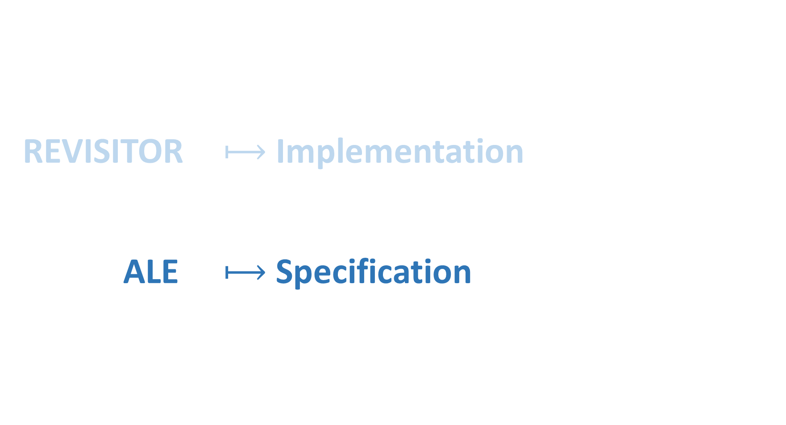
REVISITOR $⟼$ Implementation ALE $⟼$ Specification

Slide 25
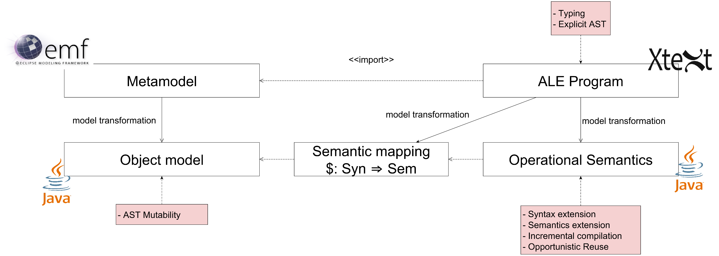
High-Level specifications
Revisitor Generation
Semantics Generation

Slide 26





ALE – Open class Operational Semantics
behavior printing;
import ecore “Fsm.ecore";
open class Machine {
def String print() {
String ret = "";
for (State s in self.states)
ret = ret + $[s].print();
return ret;
}
}
open class State {
def String print() { /* ... */ }
}
open class FinalState {
def String print() {
return "*" + $[super].print();
}
}
open class Transition {
def String print() {
return self.event + "=>" + self.tgt.name;
}
}
behavior timedprinting;
import ecore “TimedFsm.ecore”;
import ale printing;
open class TimedTransition {
def String print() {
return self.time + “@" + $[super].print();
}
}
Printing Timed FSMs
behavior execution;
import ecore “GuardedFsm.ecore”;
import ale execfsm;
import ale evalexp;
open class GuardedTransition {
def void step(String ch) {
if ($[self.guard].eval().equals(true))
$[super].step(ch);
}
}
http://www.eclipse.org/ecoretools/
[EclipeCon’17] EcoreTools Next: Executable DSL made (more) accessible
https://youtu.be/x4viqEFN7PU
Printing FSMs
Executing Guarded FSMs
Notes:
Implemented using EMF and Xtext so applicable in various modeling environment
Dedicated to help language engineers extends existing languages, customise their semantics, and combine such extensions
ALE = operational semantics + open-class like mechanism
Dire: Easier, type safe, still modular

Slide 27
Evaluation

Slide 28
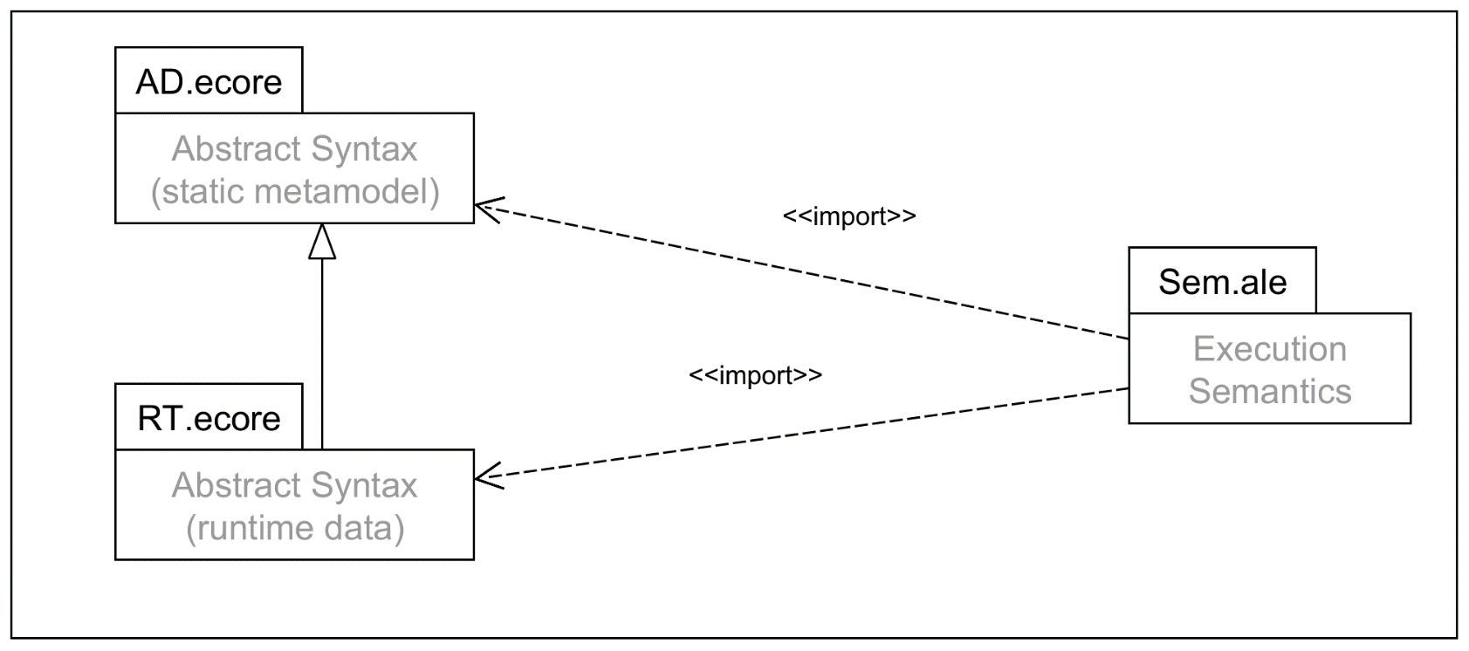
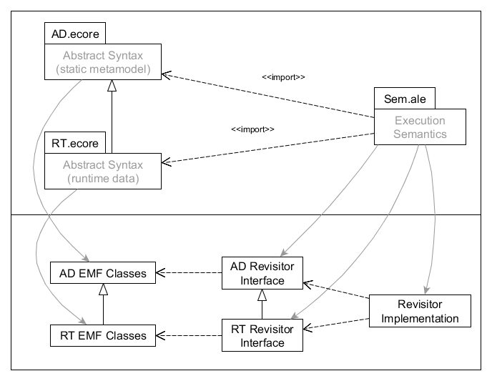
Evaluation: Modular Implementation of fUML
Notes:
AD = activities, associations …
RT = Tokens, traces…
Dire qu’on peut avoir de la modularité
Import/extends => flèches pointillées + stéréotypes entre chevrons
Generations = flèches pleines en gras

Slide 29
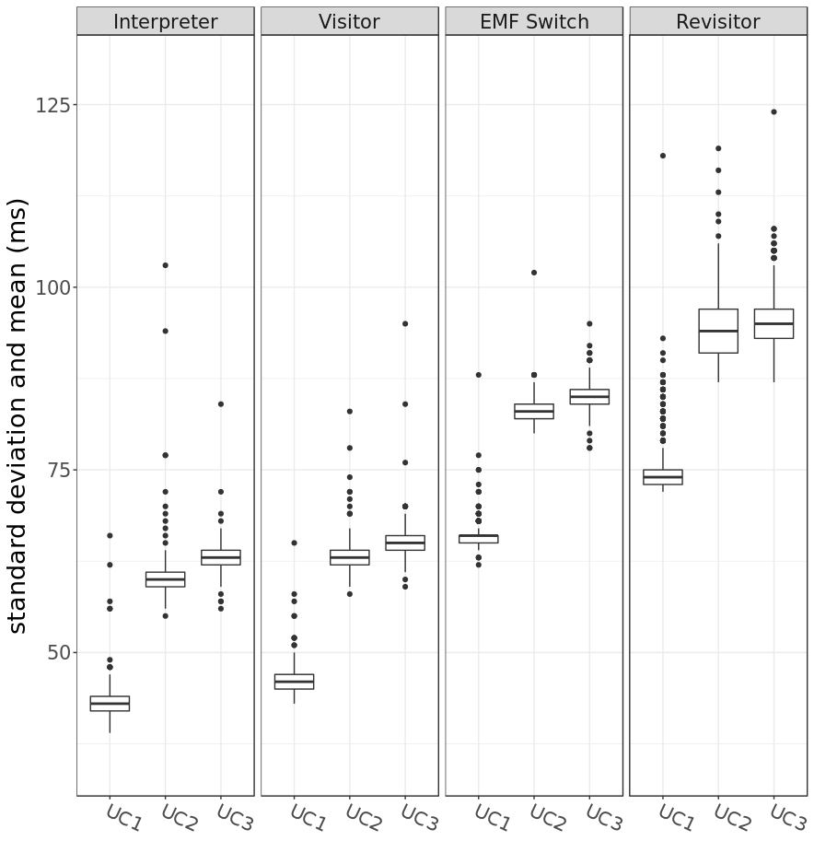
Performance Evaluation: Results
Benchmarks taken from the Transformation Tool Contest (TTC’15)
Same semantics for all implementations.
↗ Modularity Execution time
≈
Notes:
Emphazing on: It’s still practical

Slide 30
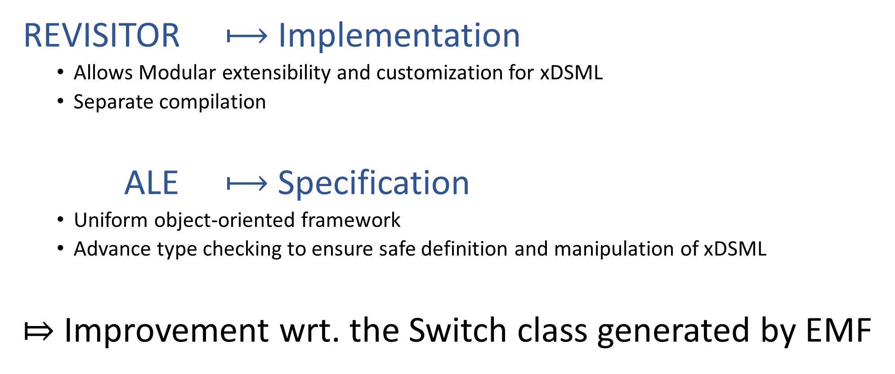
Take away
REVISITOR $⟼$ Implementation
Allows Modular extensibility and customization for xDSML
Separate compilation
ALE $⟼$ Specification
Uniform object-oriented framework
Advance type checking to ensure safe definition and manipulation of xDSML
⤇ Improvement wrt. the Switch class generated by EMF
Notes:
Portable to other technical spaces (any OO language)
Rappeler les propriétés cités slide de présentation de l’approche globale
Futur work:
Towards language modules
Application of the REVISITOR pattern for translational semantics (Compilers)

Slide 31
EOF

Slide 32
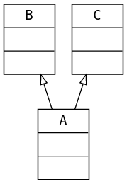
Multiple Inheritance
Multiple bound available interface ABCRev<AT, BT, CT extends AT & BT> { /*...*/ }
Otherwise
interface ABCRev<AT, BT, CT, CT_A extends AT, CT_B extends BT> {
CT c(C c);
CT_A c_as_a(C c);
CT_B c_as_b(C c);
default AT $(A it) {
if (it instanceof C) return c_as_a((C) it);
return a(it);
}
default BT $(B it) {
if (it instanceof C) return c_as_b((C) it);
return b(it);
}
}
Notes:
First: cool but not available in java
Second: workds well as long a generated, allows different behaviour for an instance according to its static type

Slide 33
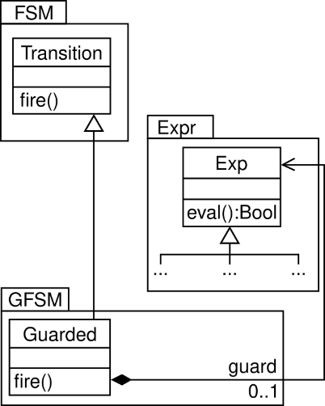
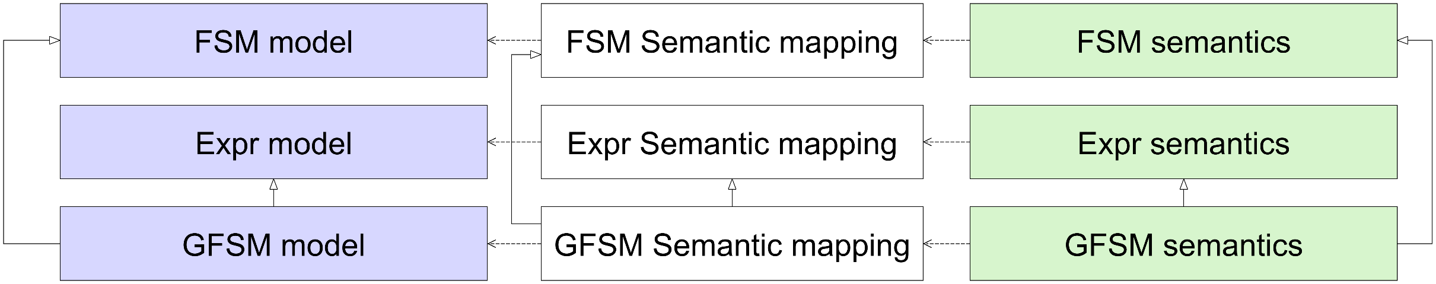
Independent extensibility
class Guarded extends Transition { Exp guard; }
interface ExecGuarded extends GuardedAlg<…>, ExecFSM, EvalExp {
default St guarded(Guarded it) {
return ch -> {
if($(it.guard).eval()) transition(it).step(ch);
};
}
}
interface GuardedRev<…> extends FSMRev<…>, ExpRev<…> {
G guarded(Guarded it);
@Override default T $(Transition it) { … }
default G $(Guarded it) { … }

